Slide 1
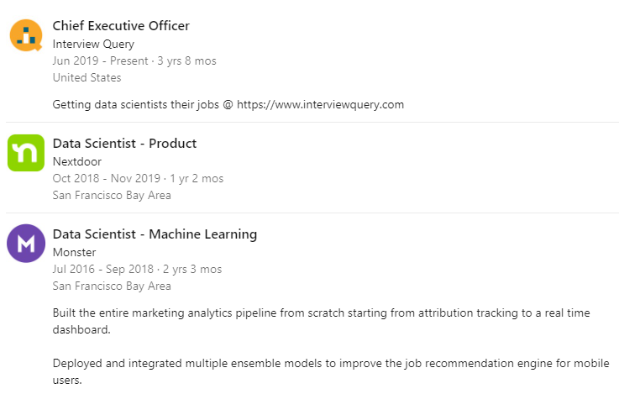
Jay Feng – CEO of Interview Query

Slide 2
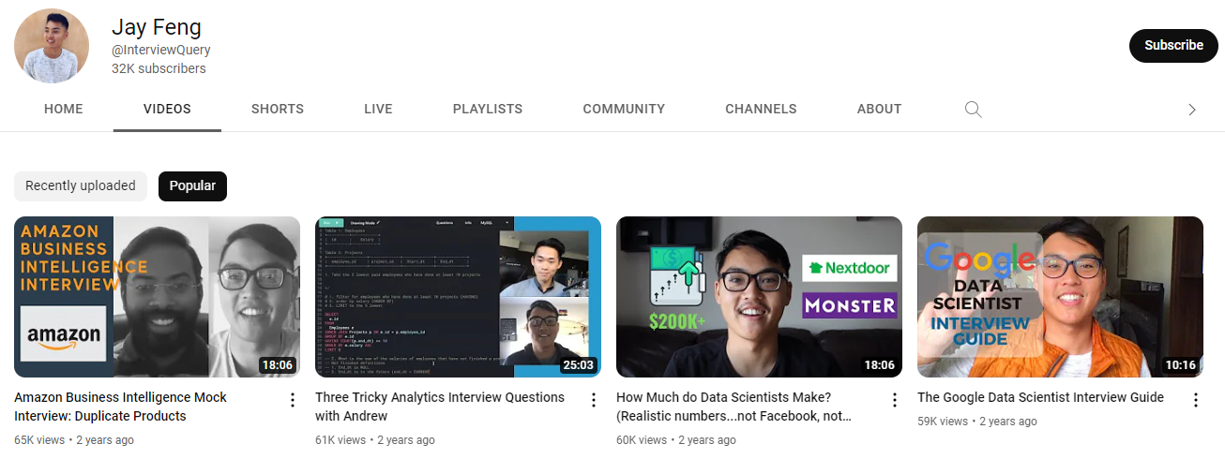
Content Creator – 32K Subs

